Slide 1


VE450 Edge Online Training
Weekly Report #3
2018.10.19

Slide 2

VE450 Course-related work
1.1 Design Review #1 -> Feedback?
1.2 Report

Slide 3
An improvement of PCA (Principle Component Analysis)
- 1.1 SPCA (Simple PCA)
Customer Requirement:
Edge computing
Adaptabilty to different motors
High testing accuracy
Fast Speed
Remote control
Another computational method of PC(principal component that is very fast)

Slide 4
Literature Research
Article: Fast Dimensionality Reduction and Simple PCA
Article: A Computationally Efficient and Adaptive Approach for Online Embedded Machinery Diagnosis in Harsh Environments

Slide 5

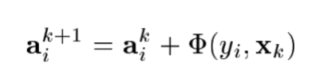

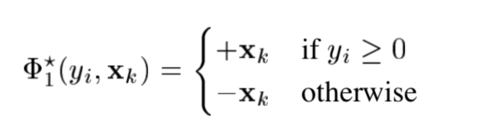

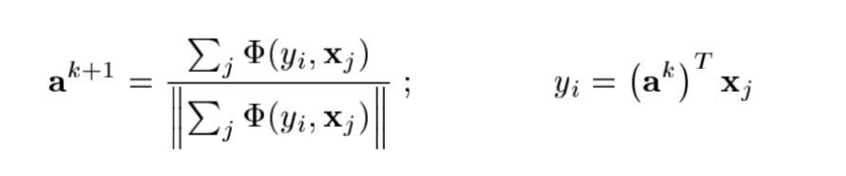
Literature Research
Traditional PCA
SPCA
or
a_{i} ^{k} - weights after k iterations;

Slide 6
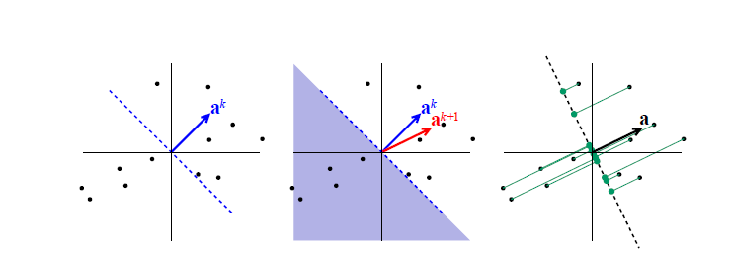
Why it faster?
1 Calculation for \phi is simpler;
2 Much fewer calculations for y_i;
3 Deflation of old principle component;

Slide 7
Future Plan
1 Implementation of SPCA;
2 Other methods?
3 Modification of project requirements;

